Slide 1
Is College Worth It?
Assessment of College Costs, Debt and Post-Graduate Income
Mosa Hasen, Abdullah Jaura, Imen Najar, Katherine Young

Slide 2
Scope and Objectives
Since 1980, the average college tuition and fees have increased 1200%. Americans at a young age continue to take on significant debt to pay for higher education while graduates years later are still struggling to repay their loans raising the question, is college worth it?
The analysis will explore and aim to answer:
Which regions have the most and least expensive schools
Which regions have the highest and lowest debt
Which regions have the highest and lowest income after graduation
Which regions offer the best return on investment for 4-year education (and which are the worst)

Slide 3
About the Sample Data
The data was sourced from the U.S. Department of Education College Scorecard
https://collegescorecard.ed.gov/data/
The sample is made up of 1,439 colleges and universities in the United States and its territories from the 2011-12 academic year that offer a Bachelor’s Degrees in at least one of the following 15 majors or fields of study:
Agriculture, Ethnic, Cultural or Gender Studies, Communications - Journalism, Computer Science / IT, Education, Engineering, English, Biological / Biomedical Science, Math, Philosophy / Religion, Psychology, Social Science, Visual / Performing Arts, Business / Marketing, History
Key metrics for analysis included:
Instate Tuition and Fees for each School
Median Debt at Graduation for each School
Debt Repayment Rate - 5 years After Graduating for each School (% of grads paying)
Mean earnings 6 years after entry
Years to Pay off Debt

Slide 4
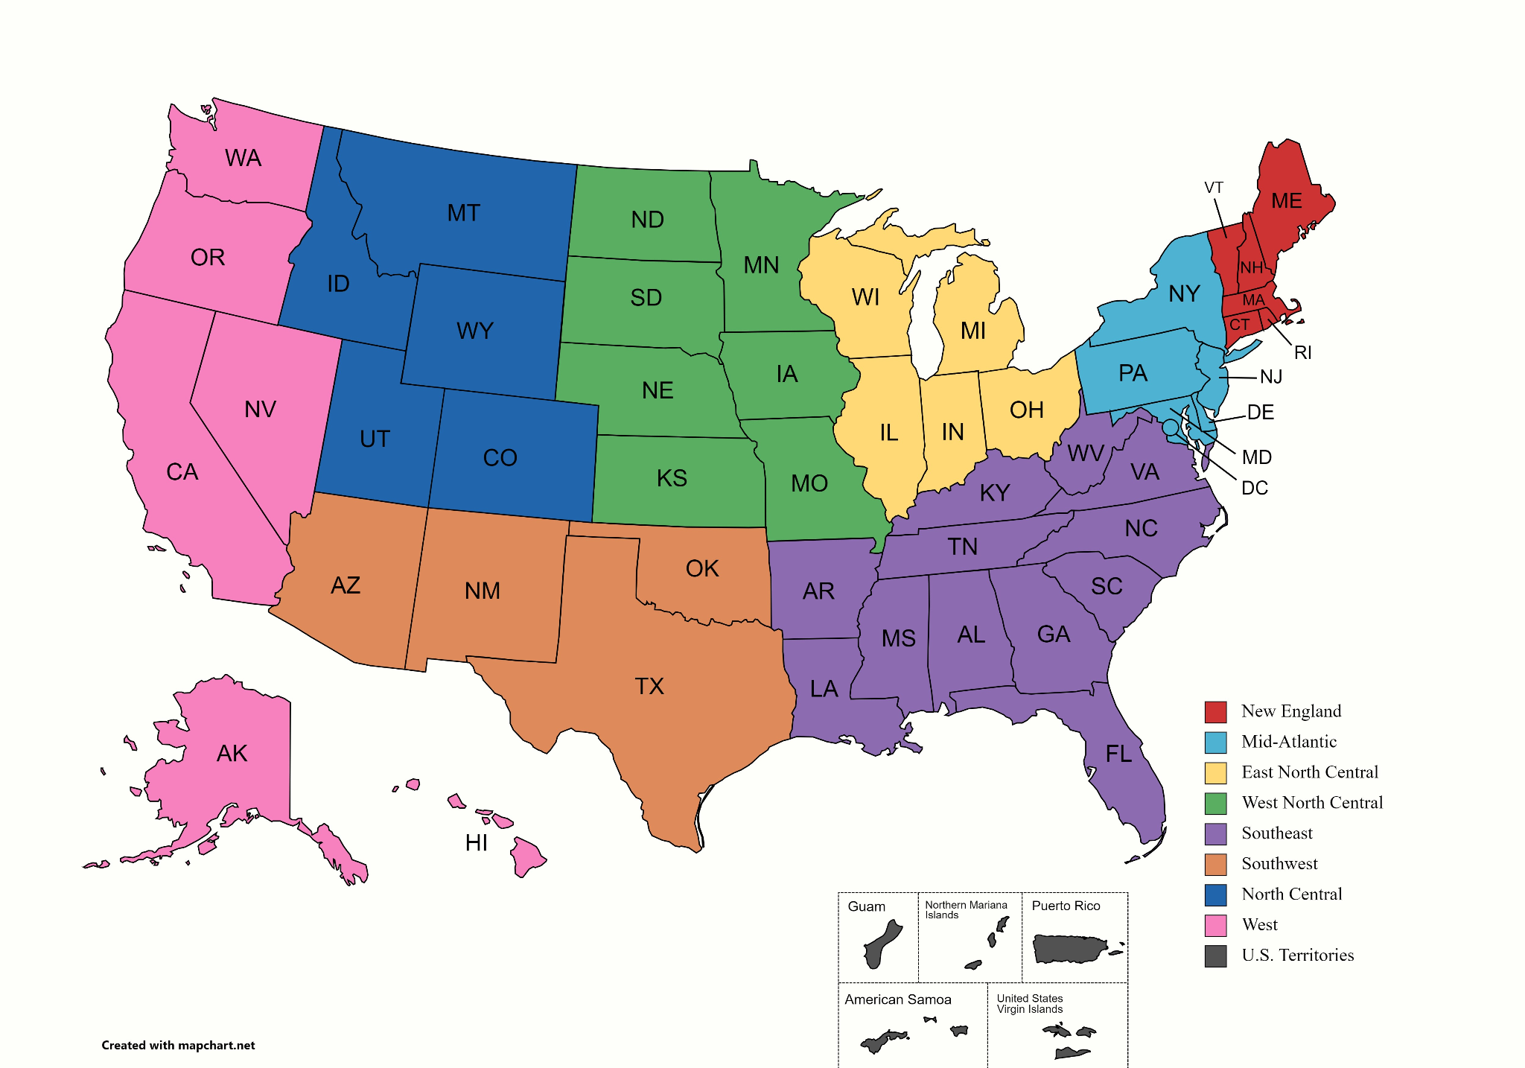
Regions of Schools
Map created on: https://www.mapchart.net/usa.html

Slide 5
Analysis

Slide 6
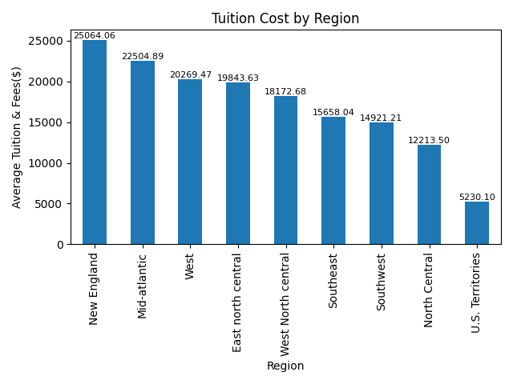
Tuition Cost Varies across Regions
There is a significant difference in tuition cost across regions (p-value=1.12e-35)
Universities/Colleges in the New England Region have the highest tuition costs, followed by the Mid-Atlantic region. In contrast, the North Central and US Territories offer the lowest tuition costs.
Notes:
Musa
Variation in tuition cost across region possibly due to the cost of living, prestige, and reputation and availability of financial aid.

Slide 7
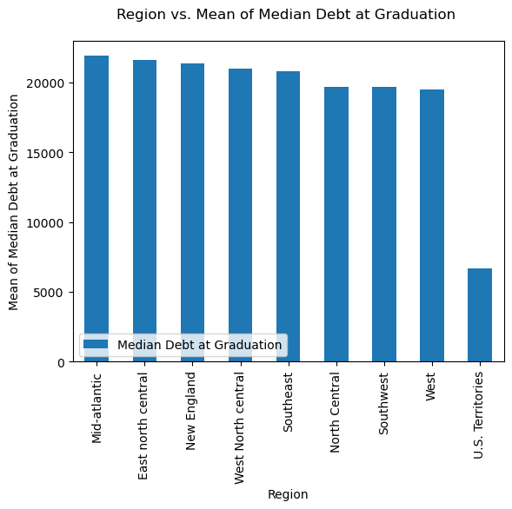
Debt at Graduation by Region
The Mid-Atlantic, East North Central, New England, West North Central and Southeast have the largest average debt, at more than $20,000. The average debt at Graduation in North Central, Southwest and West is slightly less than $20,000. Unlike the rest, the average Debt at Graduation in the US Territories is very low, less than $10,000.
We can conclude that most students, regardless of their region, have on average the same debt level–approximately $20,000–at graduation except for the US Territories.
Across all regions there are statistical differences (p-value=0.00027), but grouping specific regions together, for example the Mid-Atlantic, East North Central and New England, there is no difference in debt (p-value=0.63).
Notes:
Imen

Slide 8
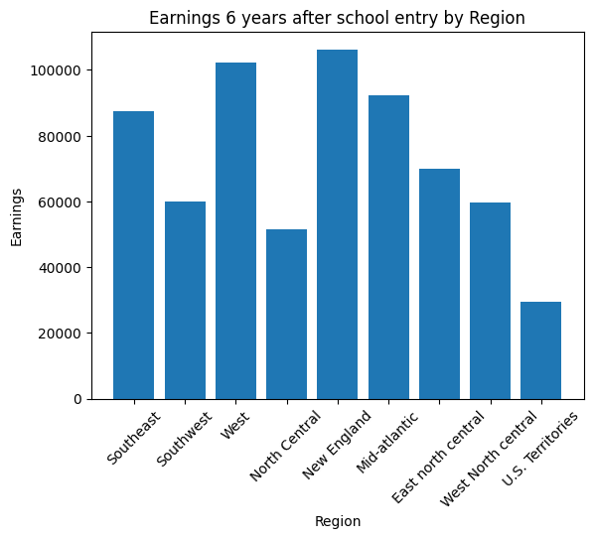
Student Earnings Varies by Region
Earnings not distributed evenly by region
More industry and market presence in some regions
Earnings within the New England and Western Regions are nearly double that of the Southeast and North Central regions.
US Territories has the least and the only one below 40,000.
Excluding U.S Territories, North Central yields the least earning with a lower education system and industry opportunities
The difference in earnings is significant across all regions (p-value =1.29e-38), even among regions with similar earnings like New England and the West (p-value =0.13)
Notes:
Abdullah

Slide 9
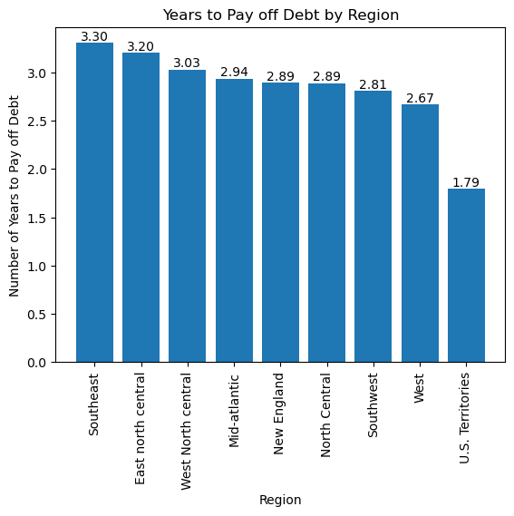
Students by Region will Pay Off Debt at Differing Rates
Assuming debt is fixed and graduates contribute 20% of a static income every year, students can repay debt in about 3 years in all US regions.
Testing statistical significance across all regions, there is a significant difference in time to pay off debt. (p-value =3.16e-13).
These differences are present between the top 2 regions Southeast and East North Central US. (p-value =0.34)
Notes:
Kat

Slide 10
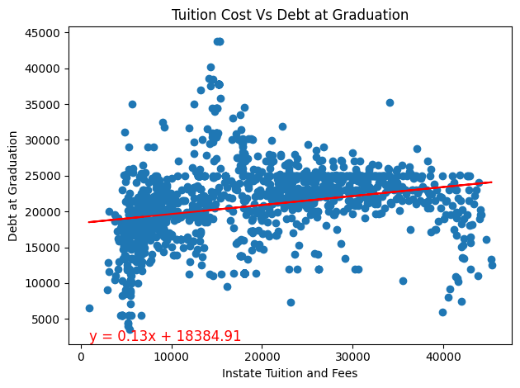
Weak Correlation: Tuition Cost and Debt
at Graduation
Correlation coefficient (r= 0.22) suggests a weak positive relationship.
As tuition cost increases, there is a slight tendency for the debt at graduation to increase as well.
Notes:
Musa
Very weak correlation existed between tuition cost and debt at graduation as possibly due to the fact that Debt at graduation can also be influenced by other factors such as savings/family supports, financial aid…

Slide 11
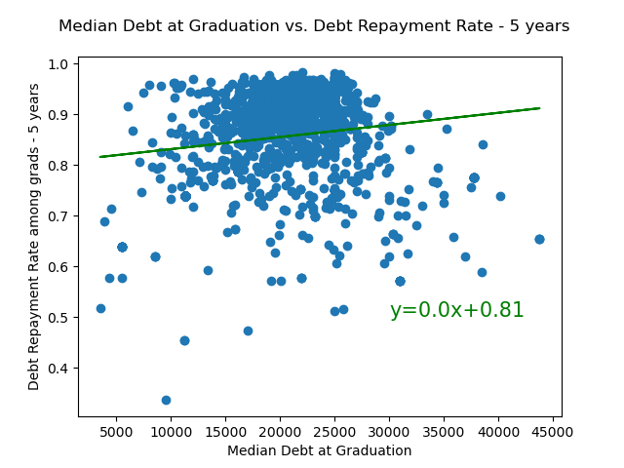
Relationship between Median Debt at Graduation and Debt Repayment Rate - 5 years
The correlation between Median Debt at Graduation and Debt Repayment Rate -- 5 years is very weak.
The r-value is 0.158, (very weak positive correlation).
The r-value is not significant, so a regression analysis is not applicable. Other factors can affect the Debt Repayment Rate but not the Median Debt at Graduation.
Notes:
Imen

Slide 12
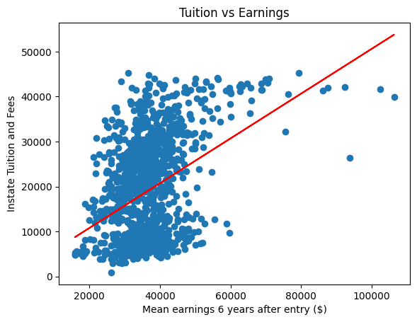
Higher Earnings Are Generally Accompanied by Higher Tuition
Majority of the Tuition cost generally stays under $40,000 with most graduates making less than $60,000
Few Outliers earn around 80,000 or more
It’s not necessarily the case that higher tuition schools will result in guaranteed higher income but generally, those who attend higher tuition schools end up with higher paying jobs.
y = 0.50x + 811.35
Notes:
Abdullah

Slide 13
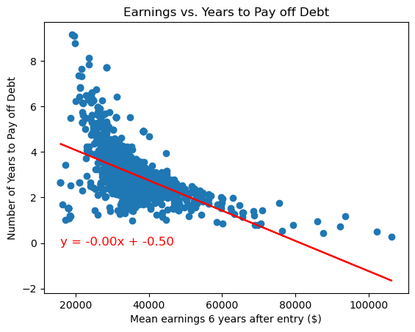
Higher Earnings Results in Faster Debt Repayment
There is a moderate negative relationship (r = -0.49) between the mean earnings and time to pay off debt. As earnings increase, the rate time to pay off steadily decreases.
By region, the amount of debt is fairly consistent. This means that debt acts as a constant variable, meaning the job and income you get as a result of your education impacts how fast debt is repaid.
Notes:
Kat
The relationship is not necessarily 1 to 1 because many universities have high rates of debt repayment. Even if grads are making less, most are still making some progress towards debt.

Slide 14
Conclusion

Slide 15
Conclusions
The cost of education is not the same across the US. Depending on where students study, students will pay higher tuition rates, by region.
Debt at graduation is fairly consistent. Even though some schools cost more, debt across regions is consistent.
Attending a higher tuition school may improve your odds for a more lucrative job.
Because debt is mostly constant, income post-graduation significantly impacts speed of debt repayment.
Excluding US Territories,
College is generally most affordable in the North Central US (CO, ID, MT, UT, WY)
Earnings after graduation are highest in New England (CT, ME, MA, NH, RI, VT)
But the best ROI (in this case debt repayment speed) is in the Western US (AK, CA, HI, NV, OR, WA)

Slide 16
End of Presentation

